Slide 1
E - Form
Enrollment

Slide 2
How to Access E-Form Enrollment
Log in to Binusmaya.binus.ac.id

Slide 3
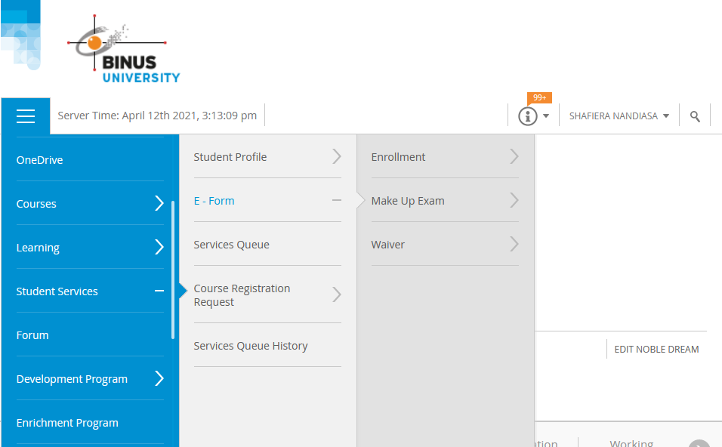
Main Menu > Student Services > E-Form > Enrollment

Slide 4
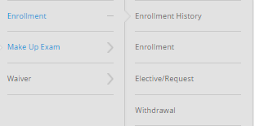
1. ENROLLMENT
Student Service > E - Form > Enrollment
Enrollment History : Displays the history of submitted Enrollment, Elective, Request and Withdrawal E – Form.
Enrollment : This menu helps student to request a courses that have failed or pass with a minimum score.
Elective/ Request : This menu helps student to request a courses (except the majors that student have been taken)
Withdrawal : This menu helps student to drop the Enrollment that has been taken.

Slide 5
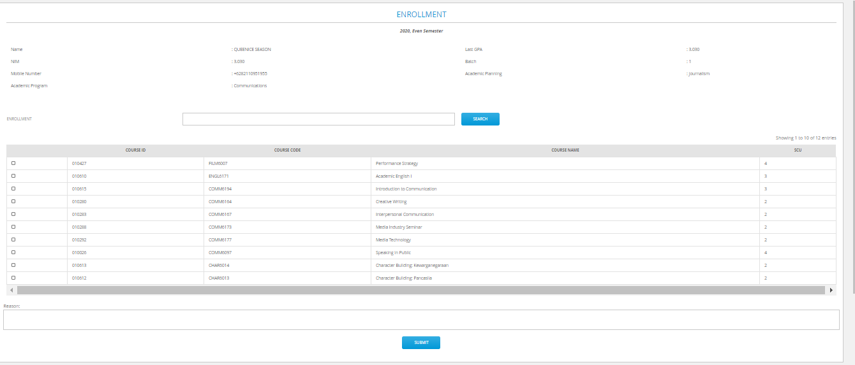
3
2
3
Enrollment
Page
GUIDELINES :
Student open the Enrollment E – Form Page
System displays the courses that eligible to enroll by student (courses that have failed or pass with a minimum score)
Student choose the courses that eligible to enroll by clicking the checkbox near the course ID > Click Submit
After submitted, Enrollment E – Form data will be notified by email to JWC Staff and student.
HTTPS://BINUSMAYA.BINUS.AC.ID/NEWSTUDENT/#/STUDENTSERVICES/EFORM/ENROLLMENTFORM/ENROLLMENT.HTML

Slide 6
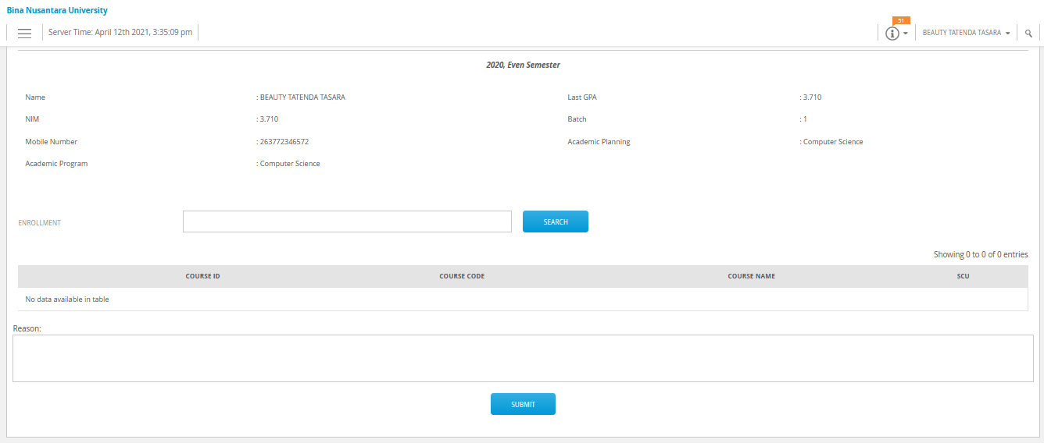
Enrollment
Page
If there are no courses shown on your enrollment page menu, it means the course(s) that you want is not open. Then you need to go to the “elective/request” menu. (read the next slide)

Slide 7
Elective/ Request Page
GUIDELINES :
Student Open the Enrollment Elective/ Request Page
This page will display a drop list that can set the chosen page (Elective Page /Request page)
After choosing the E – Form Enrollment/ E – Form Request page, students click “ADD NEW” button
For Request Enrollment, Student can type the course name in the Request Course section.
After completing the require data > Click “Submit”
System will notify the submitted E – Form to staff and student by email
2
3
4
5
HTTPS://BINUSMAYA.BINUS.AC.ID/NEWSTUDENT/#/STUDENTSERVICES/EFORM/ENROLLMENTFORM/ELECTIVEANDREQUEST.HTML

Slide 8
Elective/ Request Page
GUIDELINES :
Student Open the Enrollment Elective/ Request Page
This page will display a droplist that can set the chosen page (Elective Page /Request page)
After choosing the E – Form Enrollment/ E – Form Elective page, students click “ADD NEW” button
For Elective Enrollment, Student can choose the courses by majors in the Elective Page Droplist “Jurusan”
After completing the require data > Click “Submit”
System will notify the submitted E – Form to staff and student by email
2
3
4
5
HTTPS://BINUSMAYA.BINUS.AC.ID/NEWSTUDENT/#/STUDENTSERVICES/EFORM/ENROLLMENTFORM/ELECTIVEANDREQUEST.HTML

Slide 9
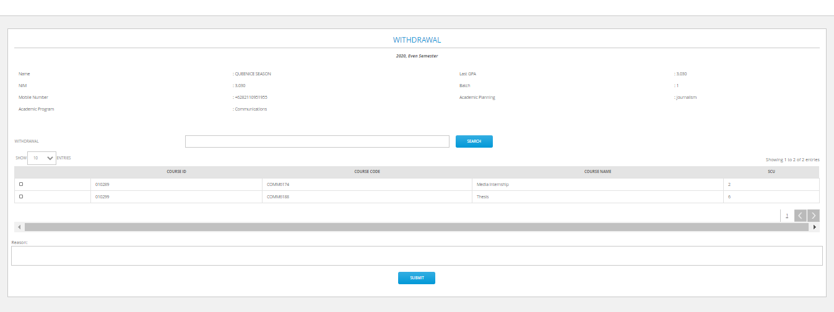
Withdrawal Page
3
2
4
5
GUIDELINES :
Student open withdrawal E – Form : E - Form > Enrollment >Withdrawal
Withdrawal menu will show the submitted Request Enrollment E – Form .
Student click courses checkbox to select the courses that student want to drop
Student can write the reason in the available column
After completing the data, student click “Submit”
HTTPS://BINUSMAYA.BINUS.AC.ID/NEWSTUDENT/#/STUDENTSERVICES/EFORM/ENROLLMENTFORM/WITHDRAWAL.HTML

Slide 10
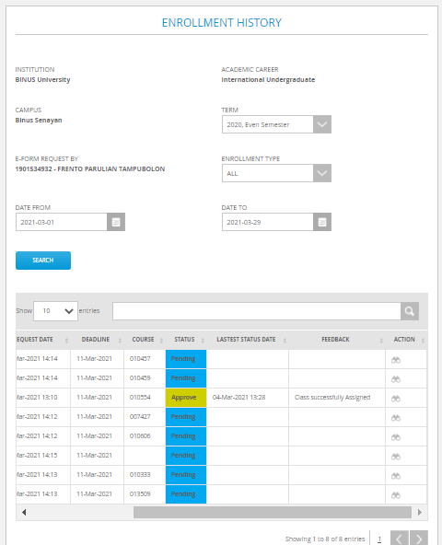
Enrollment History Page
2
GUIDELINES :
3
4
Student open Enrollment History Menu
Student choose the Enrollment Term that needed to display the History Enrollment Request by term
Choose the Enrollment Type which will be displayed (All/ Enrollment/ Elective/ Request/ Withdrawal)
Choose the range of date of the submitted E – Form which will be displayed
Click “Search”
System will display the History data of the submitted E – Form
5
6
HTTPS://BINUSMAYA.BINUS.AC.ID/NEWSTUDENT/#/STUDENTSERVICES/EFORM/HISTORY/ENROLLMENTHISTORY

Slide 11
You will get a notification by email if your enrollment request is approved or rejected. The notification will be sent to your BINUS email. Please check your BINUS email regularly to prevent any misinformation.

